Slide 1
OOP & data struct 6. Utility
By Somsin Thongkrairat

Slide 2
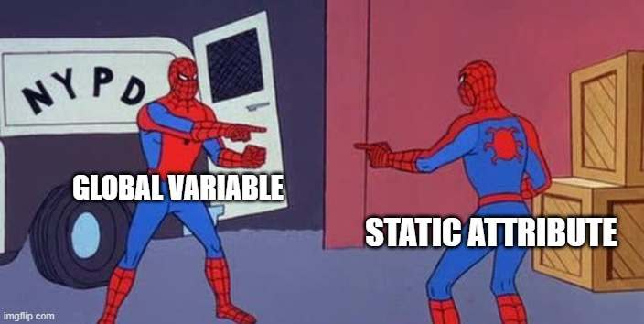

Slide 3
Utility
- static variable
- Templates

Slide 4
static variable
- one variable for a class (like a global variable)
- เป็นตัวแปรตัวเดียวที่ใช้ได้กับทั้ง class (เหมือนกับ global variable)

Slide 5
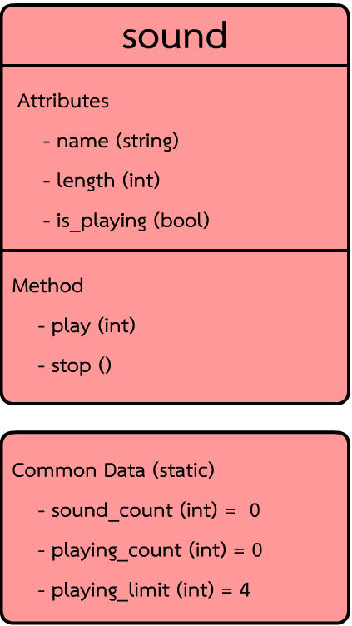
object
S1
Each Object component
S2
S3
S4
Common class component
S5

Slide 6
Syntax
Static variable declaration
static [variable declaration];
class sound{
public :
static int playing_limit;
static int playing_count;
static int sound_count;
6_1_static_variable

Slide 7
usage
int sound::sound_count = 0; // init
int sound::playing_count = 0; // init
int sound::playing_limit = 4; // init
int main(){
cout << sound::sound_count << endl;
Result : 0
Must initialize outside of main
ต้องกำหนดค่าเริ่มต้นนอกฟังก์ชัน main

Slide 8
Example
sound(string _name){
name = _name;
sound_count++;
}
Unlike normal attribute static member call common data of its class
ไม่เหมือนกับตัวแปรทั่วไป ตัวแปร static จะไปเรียกข้อมูลที่ใช่ร่วมกันใน class

Slide 9
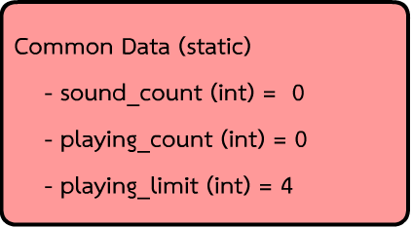
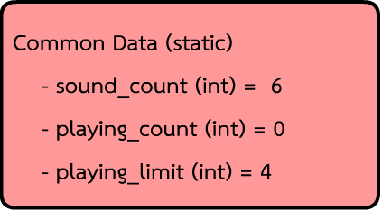
cout << sound::sound_count << endl;
sound s1("Som san");
sound s2("Jai sang ma");
sound s3("s3");
sound s4("s4");
sound s5("s5");
sound s6("s6");
cout << sound::sound_count << endl;
Result : 0
6

Slide 10
sound(string _name){
name = _name;
sound_count++;
cout << "this sound number : " << sound_count << endl;
}
Result :
0
this sound number : 1
this sound number : 2
this sound number : 3
this sound number : 4
this sound number : 5
this sound number : 6
6
Code :
cout << sound::sound_count << endl; sound s1("Som san");
sound s2("Jai sang ma");
sound s3("s3");
sound s4("s4");
sound s5("s5");
sound s6("s6"); cout << sound::sound_count << endl;

Slide 11
warning
0
this sound number : 1
this sound number : 2
this sound number : 3
this sound number : 4
this sound number : 5
this sound number : 6
this sound number : 7
7
cout << sound::sound_count << endl; sound s1("Som san");
sound s2("Jai sang ma");
sound s3("s3");
if(true){
sound s7("song yang bad");
}
sound s4("s4");
sound s5("s5");
sound s6("s6"); cout << sound::sound_count << endl;

Slide 12
Quiz
How to solve it?

Slide 13
Play method
void play(){
if(is_playing == true){
cout << name << " is still playing " << endl;
return;
}
else{
is_playing = true;
playing_count++;
cout << "playing " << name << endl;
}
}

Slide 14
Stop method
void stop(){
if(is_playing == false){
cout << name << " is not playing " << endl;
}
else{
is_playing = false;
playing_count--;
}
}

Slide 15
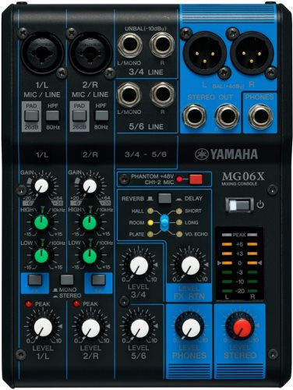
Another example
Sound mixer
Can play only 4 sound at a time
สามารถเล่นได้แค่ 4 เสียงในหนึ่งๆ เวลา

Slide 16
Solution
- create global variable and count (non - OOP)
- using data struct such as queue stack (not elegant!)
- using static variable to count playing sound (very elegant!)
- สร้างตัวแปร global เพื่อนับ (non - OOP)
- ใช้ data struct เช่น คิว หรือ stack (not elegant!)
- ใช้ตัวแปร static เพื่อนับจำนวนของเพลงที่เล่น (very elegant!)

Slide 17
int sound::sound_count = 0; // init
int sound::playing_count = 0; // init
int sound::playing_limit = 4; // init
int main(){
cout << sound::sound_count << endl;
Set limit
Added to play
if(playing_count >= playing_limit){
cout << "playlist is full, can't play " << name << endl;
}

Slide 18
void play(){
if(is_playing == true){
cout << name << " is still playing " << endl;
return;
}
if(playing_count >= playing_limit){
cout << "playlist is full, can't play " << name << endl;
}
else{
is_playing = true;
playing_count++;
cout << "playing " << name << endl;
}
}

Slide 19
s1.play(); // playing Som san
s2.play(); // playing Jai sang ma
s3.play(); // playing s3
s4.play(); // playing s4
s5.play(); // playlist is full, can't play s5
s6.play(); // playlist is full, can't play s6
s1.stop();
s6.play(); // playing s6
s1.stop(); // Som san is not playing
s2.stop();
s2.stop(); // Jai sang ma is not playing
cout << sound::playing_count << endl; // 3

Slide 20
Static method
static void print(){
cout << "total sound is : [" << sound_count << "] now playing [" << playing_count << "]" << endl;
}
static int get_playing_count(){
return playing_count;
}
static int get_sound_count(){
return sound_count;
}
And make static attribute as private !
เปลี่ยน static attribute ให้เป็น private ได้!

Slide 21
Static member
- can be both attribute or method and can modify as public or private
- the common component of whole class (like global variable or global function)
- สามารถมีได้ทั้ง attribute และ method และสามารถ modify ให้เป็น public หรือ private
- เป็นส่วนประกอบที่ใช้ร่วมกันทั้ง class (เหมือนตัวแปร global และ function)

Slide 22
Templates
- allow to create function that can custom datatype inside a function
- สามารถสร้าง function ที่กำหนดชนิดของข้อมูล datatype ที่ใช้ใน function ได้

Slide 23
Syntax
template <class identifier,…> function_declaration;
template <typename identifier,…> function_declaration;

Slide 24
Back to our friend
int multiply_int_int(int a,int b){
int c = a * b;
return c;
}
float multiply_int_float(int a,float b){
float c = a * b;
return c;
}
float multiply_float_int(float a,int b){
float c = a * b;
return c;
}

Slide 25
Turn it into
template <typename myType> myType multiple(myType a ,myType b){
myType c = a * b;
return c;
}
Usage :
Result :
12
15
18
int a = multiple<int>(3,4);
float b = multiple<float>(3,5);
double c = multiple<double>(3,6);
cout << a << endl;
cout << b << endl;
cout << c << endl;

Slide 26
template <typename myType> myType multiple(myType a ,myType b){
myType c = a * b;
return c;
}
Replace “myType” with input type (int) / เปลี่ยน “myType. ให้เป็น type ที่ใส่เข้าไป (int)
int a = multiple<int>(3,4);
int multiply(int a,int b){
int c = a * b;
return c;
}

Slide 27
float multiply(float a,float b){
float c = a * b;
return c;
}
float b = multiple<float>(3,5);
double c = multiple<double>(3,6);
double multiply(double a,double b){
double c = a * b;
return c;
}

Slide 28
2 type name no problem!
template <typename T,typename U> T multiple(T a ,U b){
T c = a * b;
return c;
}

Slide 29
int d = multiple<float, int>(3,7);
float e = multiple<float, float>(3,8);
double f = multiple<double, float>(3,9);
cout << d << endl;
cout << e << endl;
cout << f << endl;
Result :
21
24
27

Slide 30
Another example
template <typename T> void selection_sort(T a[],int n){
for(int i=0;i<n;i++){
int min_idx = i;
for(int j=i;j<n;j++){
if(a[j] < a[min_idx]){
min_idx = j;
}
}
T tmp = a[min_idx];
a[min_idx] = a[i];
a[i] = tmp;
}
}

Slide 31
template <typename T> void print_array(T a[],int n){
for(int i=0;i<n;i++){
cout << a[i] << " ";
}
cout << endl;
}
Sort and print function can handle all of data type
ฟังก์ชัน sort และ print สามารถรองรับตัวแปรได้ทุกชนิด

Slide 32
int my_int[] = {5,6,8,4,1,3,9,11,2};
char my_char[] = {'e','a','i','u','o'};
double my_double[] = {5.3,6.4,8.3,6.5,9.3,4.4,1.2,2.6};
selection_sort<int>(my_int,sizeof(my_int)/sizeof(int));
print_array<int>(my_int,sizeof(my_int)/sizeof(int));
selection_sort<char>(my_char,sizeof(my_char)/sizeof(char));
print_array<char>(my_char,sizeof(my_char)/sizeof(char));
selection_sort<double>(my_double,sizeof(my_double)/sizeof(double));
print_array<double>(my_double,sizeof(my_double)/sizeof(double));
1 2 3 4 5 6 8 9 11
a e i o u
1.2 2.6 4.4 5.3 6.4 6.5 8.3 9.3

Slide 33
interested question
template <typename T> class prototype_calculator{
static int operate_count; public :
virtual T add(T x,T y) = 0;
virtual T subtract(T x,T y) = 0;
virtual T multiply(T x,T y) = 0;
virtual T sum(T x1,T x2=0,T x3=0,T x4=0,T x5=0) = 0;
};

Slide 34
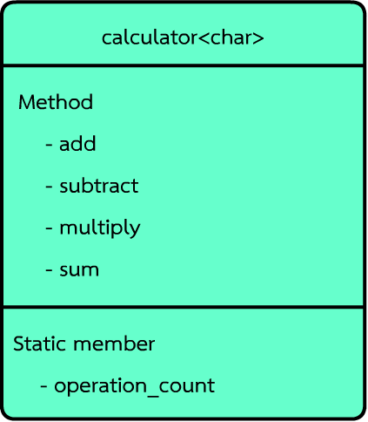


Shared static member?

Slide 35
C++
- NO!
- ไม่

Slide 36
universal_calculator<int> int_calculator;
universal_calculator<float> float_calculator;
universal_calculator<double> double_calculator;
universal_calculator<char> char_calculator;
- Each object is in individual class
- object แต่ละตัวอยู่คนละ class กัน

Slide 37
universal_calculator<int>::operator_count
universal_calculator<float>::operator_count universal_calculator<double>::operator_count
universal_calculator<char>::operator_count
- Individual item
- คนละตัวแปร

Slide 38
LAB

